Slide 1
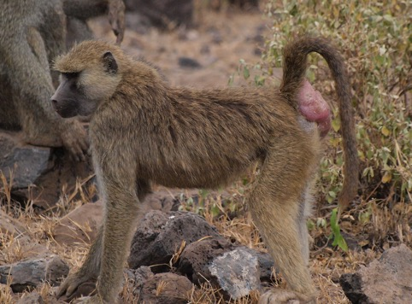
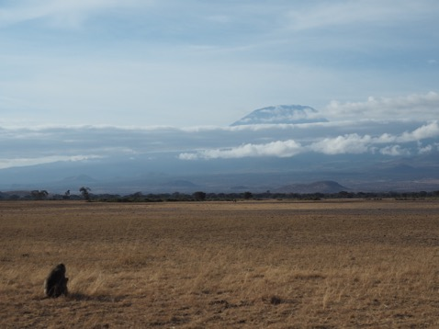
Baboon reproduction: Linking sexual swellings, estrogen, and mating behavior
Ali Galezo & Emily Levy

Slide 2
Learning objectives
Increase coding skills in R
Increase understanding of wild animal reproduction
Increase science literacy skills
Notes:
Increase coding skills in R
Write code to pull descriptive statistics and make plots
Increase understanding of wild animal reproduction
Identify associations between baboon sexual swellings, hormones, and mating behavior
Increase science literacy skills
Think critically about data, explain findings

Slide 3
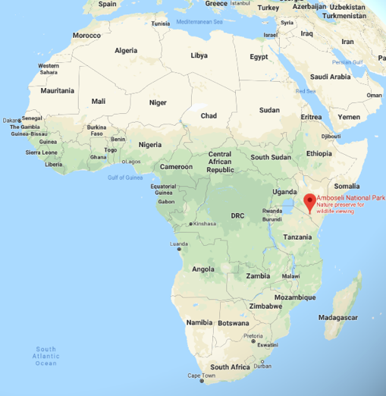

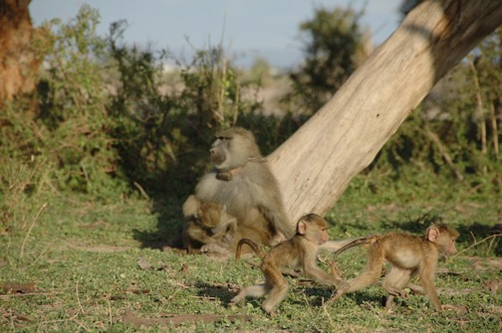
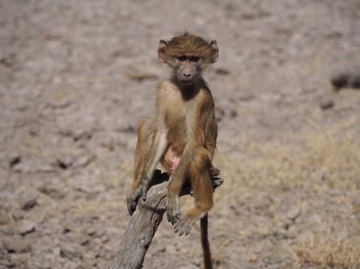
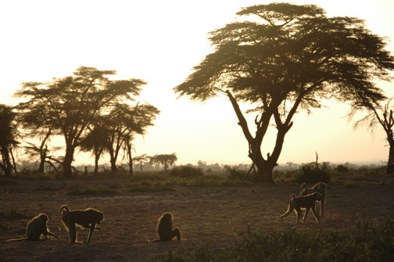
Amboseli Baboon Research Project
Continuous data collection since 1971
Individuals identified by sight
~300 living individuals across 5 social groups; ~2000 individuals over whole study

Slide 4




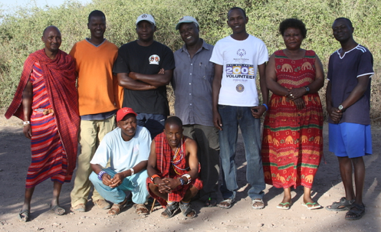
Amboseli Baboon Research Project
Susan Alberts
Jenny Tung
Beth Archie
Jeanne Altmann
Kinyua Warutere
Raphael Mututua
Long’ida Siodi
Serah Sayialel
Notes:
Top: Project directors. Jeanne and Stuart Altmann came to Amboseli in the late 1960s to start the project.
Bottom: Full-time field staff. Left to right: Moonyoi, Nkii, Kinyua, Raphael, Long’ida, Serah, Benard; Lower row: Gideon, Alex.
Kinyua, Raphael, Long’ida, and Serah are the field observers who collected nearly all behavioral and swelling data for this dataset. (Serah retired in 2018).
Benard, Gideon, and Alex are drivers and also process fecal samples. Nkii is the camp cook, and Moonyoi helps keep camp running.
It’s a massive group effort!

Slide 5
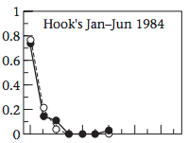
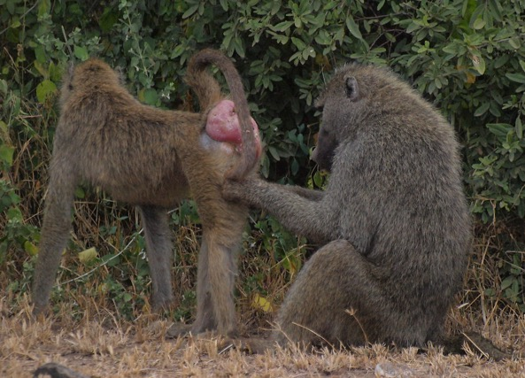
Baboon social lives
Multi-male, multi-female groups
Non-seasonal breeders
Very few females ovulating simultaneously
Females are monopolizable
Dominance rank determines resource access
Females: food & social partners
Males: ovulating females
Proportion of Consort Time
High Low
Male Rank
Post 1980 Folia Primat; Archie 2014 PRoC B; Alberts et al 2003 Animal Behav
Notes:
Both males and females mate with multiple partners
Males can monopolize females by mate-guarding them

Slide 6
Female baboon reproductive cycle
Notes:
Focus on estrogen’s peak, which aligns with ovulation (and thus peak fertility or chance of conception)

Slide 7
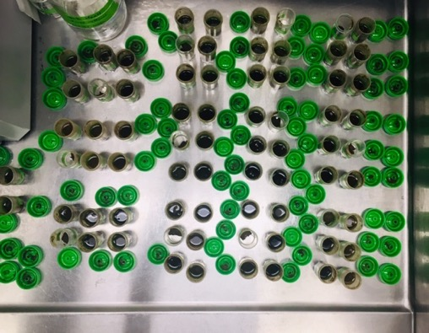
Female baboon reproductive cycle
Feces → Estrogen
Notes:
We can measure estrogen non-invasively by collecting lots and lots of baboon poop!

Slide 8
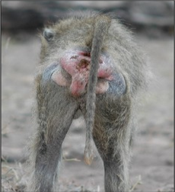
Female baboon reproductive cycle
Fischer et al 2019 eLife
Notes:
In addition to looking at estrogen in poop, we can also learn about the reproductive phase of a baboon by looking at her butt.
Perineum (skin around the ischial callosities) swells during the follicular phase of sexual cycle
Injecting females with estradiol induces a swelling – so does fresh grass, which has phytoestrogens!

Slide 9
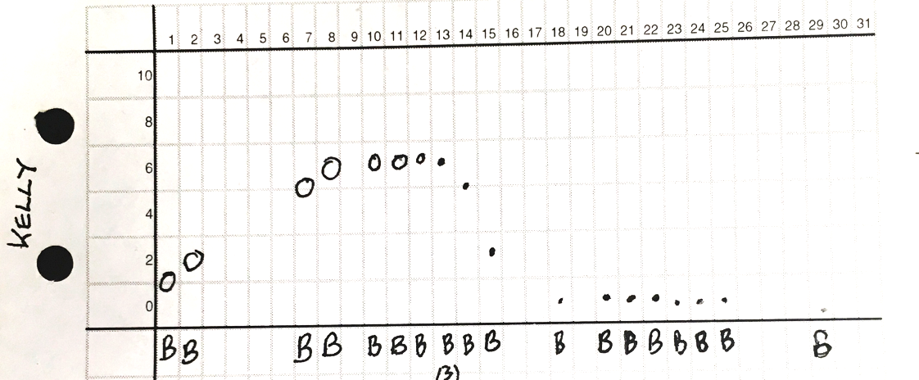
Female baboon reproductive cycle
Swelling size
Fischer et al 2019 eLife
Notes:
Field observers collect near-daily measures of female sexual swelling size. Here, each row is a day of the month, and the y-axis is swelling size (rang 0-10).
This female, Kelly, was at her peak swelling from the 8-13th
Perineum swells during follicular phase of sexual cycle
(Injecting females with estradiol induces a swelling – so does fresh grass, which has phytoestrogens!

Slide 10
Hypotheses & Predictions
Hypothesis 1: female sexual swellings are a cue of fertility that males can use to prioritize mating with fertile females
Prediction 1: peak estrogen (and ovulation) coincide with peak sexual swelling
Prediction 2: males consort with females more when females have large swellings than when they don’t have large swellings
Hypothesis 2: high-ranking males are able to monopolize fertile females better than low-ranking males
Prediction: during ovulation, high-ranking males will consort with females more than low-ranking males
Notes:
Explain that the dataset we will have has (1) swelling size on every day of the cycle, (2) estrogen concentration on every day of the cycle, and (3) who consorted with females on every day of the cycle – alpha males or non-alpha males.
Ask students to come up with predictions to test these hypotheses, given the dataset

Slide 11
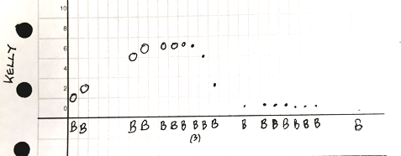
Hypotheses & Predictions
Hypothesis 1: female sexual swellings are a cue of fertility that males can use to prioritize mating with fertile females
Prediction 1: peak estrogen (and ovulation) coincide with peak sexual swelling
Prediction 2: males consort with females more when females have large swellings than when they don’t have large swellings
Hypothesis 2: high-ranking males are able to monopolize fertile females better than low-ranking males
Prediction: during ovulation, high-ranking males will consort with females more than low-ranking males`

Slide 12
Hypotheses & Predictions
Hypothesis 1: female sexual swellings are a cue of fertility that males can use to prioritize mating with fertile females
Prediction 1: peak estrogen (and ovulation) coincide with peak sexual swelling
Prediction 2: males consort with females more when females have large swellings than when they don’t have large swellings
Hypothesis 2: high-ranking males are able to monopolize fertile females better than low-ranking males
Prediction: during ovulation, high-ranking males will consort with females more than low-ranking males

Slide 13
Hypotheses & Predictions
Hypothesis 1: female sexual swellings are a cue of fertility that males can use to prioritize mating with fertile females
Prediction 1: peak estrogen (and ovulation) coincides with peak sexual swelling
Prediction 2: males consort with females more when females have large swellings than when they don’t have large swellings
Hypothesis 2: high-ranking males are able to monopolize fertile females better than low-ranking males
Prediction: during ovulation, high-ranking males will consort with females more than low-ranking males

Slide 14
Notes:
This is what the plots should look like!

